Slide 1

Deepfake Detection
A CNN+LSTM approach for robust multimedia integrity verification

Slide 2
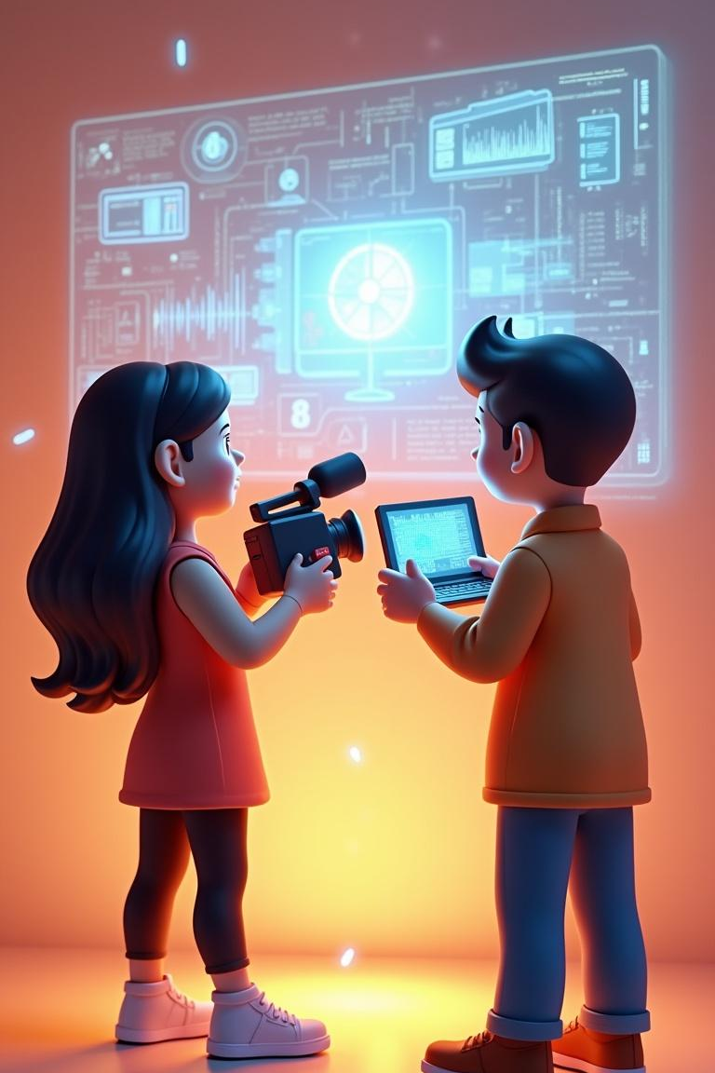
Introduction
Deepfake techniques synthesize realistic audio/video, posing risks to privacy, security, and trust.
This project develops a CNN+LSTM detection pipeline combining spatial and temporal analysis for real-time detection and forensic reliability.

Slide 3

01
Deepfake Overview

Slide 4
Definition & Types
Deepfakes are AI-generated media that alter or synthesize human likenesses.
Common types: face swaps, voice clones, puppet-master edits.
Detection focuses on artifacts in spatial frames and temporal inconsistencies across sequences.

Slide 5
Risks & Impact
Deepfakes undermine public trust, enable misinformation, and threaten personal security.
High-stakes impacts include legal challenges, election manipulation, and corporate reputational harm.
Robust detection supports accountability, mitigation, and forensic investigation.

Slide 6

Research Trends
Recent research emphasizes multi-modal detection combining spatial and temporal cues for higher robustness.
Datasets and benchmarks are expanding; focus on generalization to unseen forgeries and adversarial resilience.

Slide 7
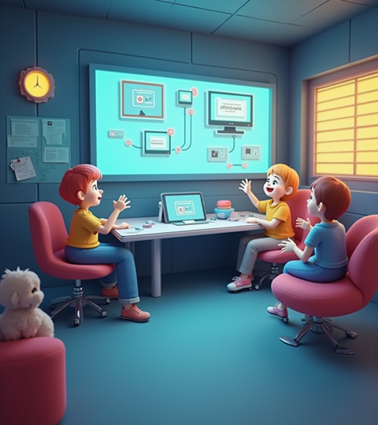
01
Detection System

Slide 8

Feature Extraction
Extract spatial features via CNNs from video frames to capture facial artifacts and texture inconsistencies.
Compute temporal features (optical flow, frame differencing) and aggregate sequences for motion irregularities.

Slide 9
Model Architecture
Hybrid pipeline: CNN backbone for frame-level features, followed by LSTM to model temporal dependencies across frames.
Final classifier uses fully connected layers with softmax for binary (real/fake) decision and probability calibration.

Slide 10
Evaluation Metrics
Measure performance using accuracy, precision, recall, and F1-score to balance false positives/negatives.
Report ROC-AUC and confusion matrix; evaluate on cross-dataset splits to test generalization.

Slide 11
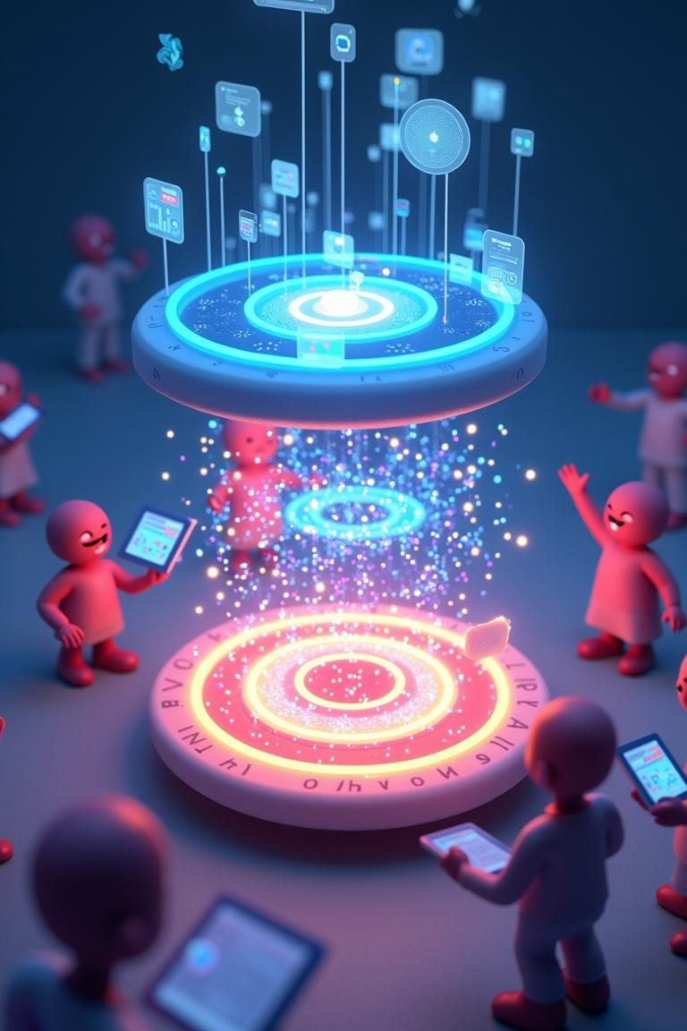
Conclusions
The proposed CNN+LSTM system improves detection by combining spatial and temporal analysis for robust deepfake recognition.
Future work includes larger datasets, adversarial training, and real-time deployment considerations.

Slide 12
THANK YOU
Do you have any questions?
youremail@freepik.com
+00 000 000 000
yourwebsite.com
Please keep this slide for attribution

